Slide 1



BI create reprot
View in Power BI
Last data refresh:
6/11/2020 5:16:25 PM India Standard Time
Downloaded at:
6/11/2020 5:53:16 PM India Standard Time

Slide 2


Slide 3
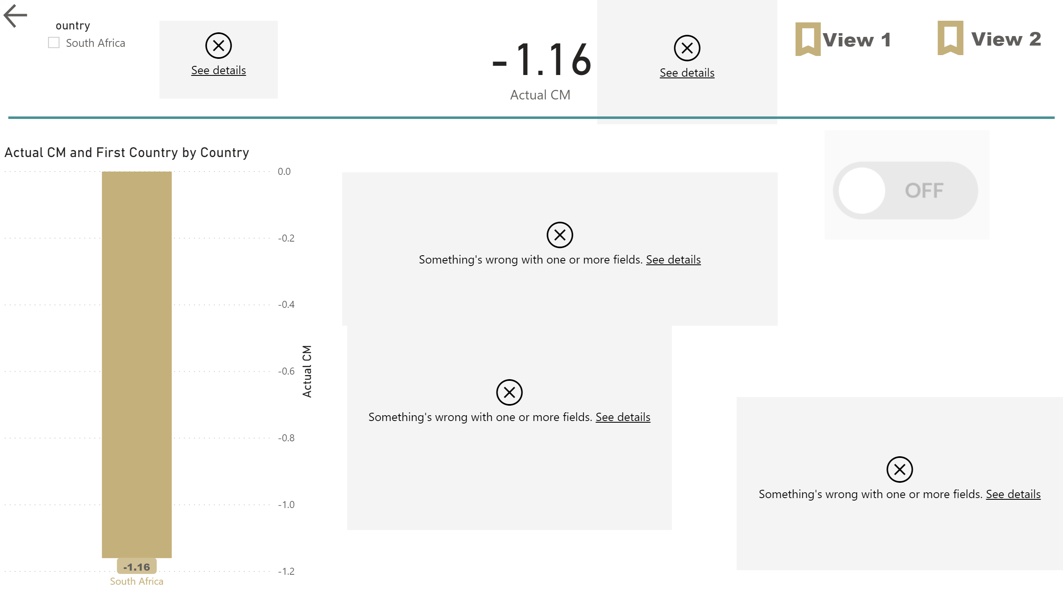

Slide 4
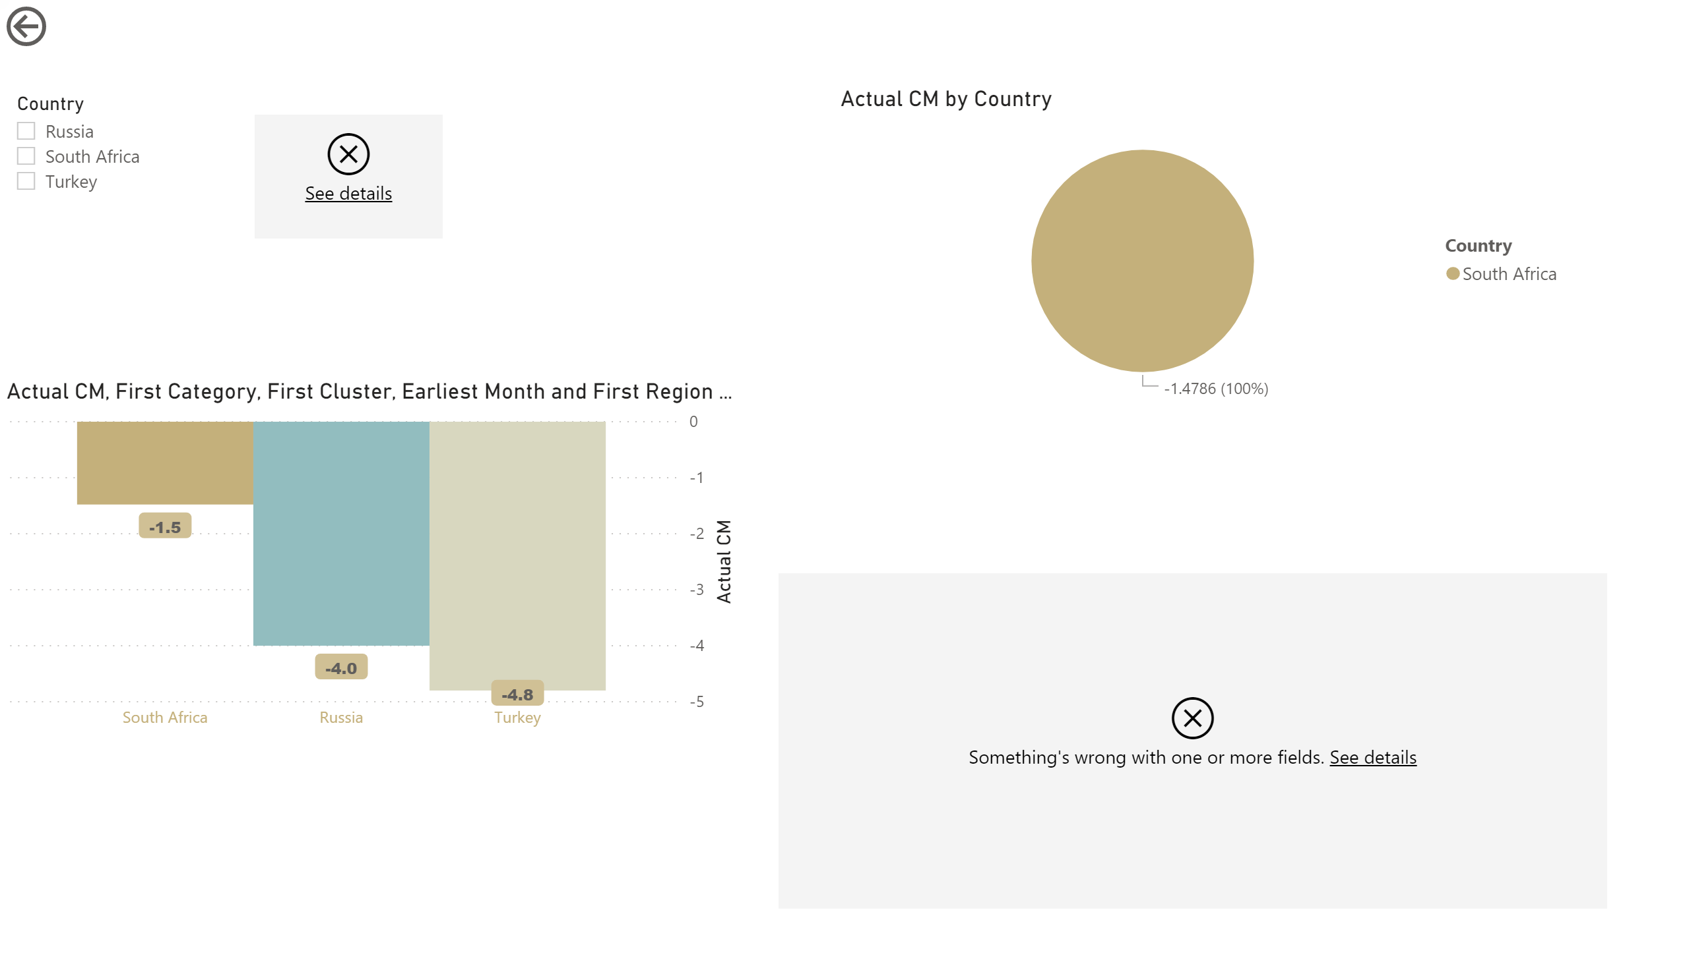

Slide 5
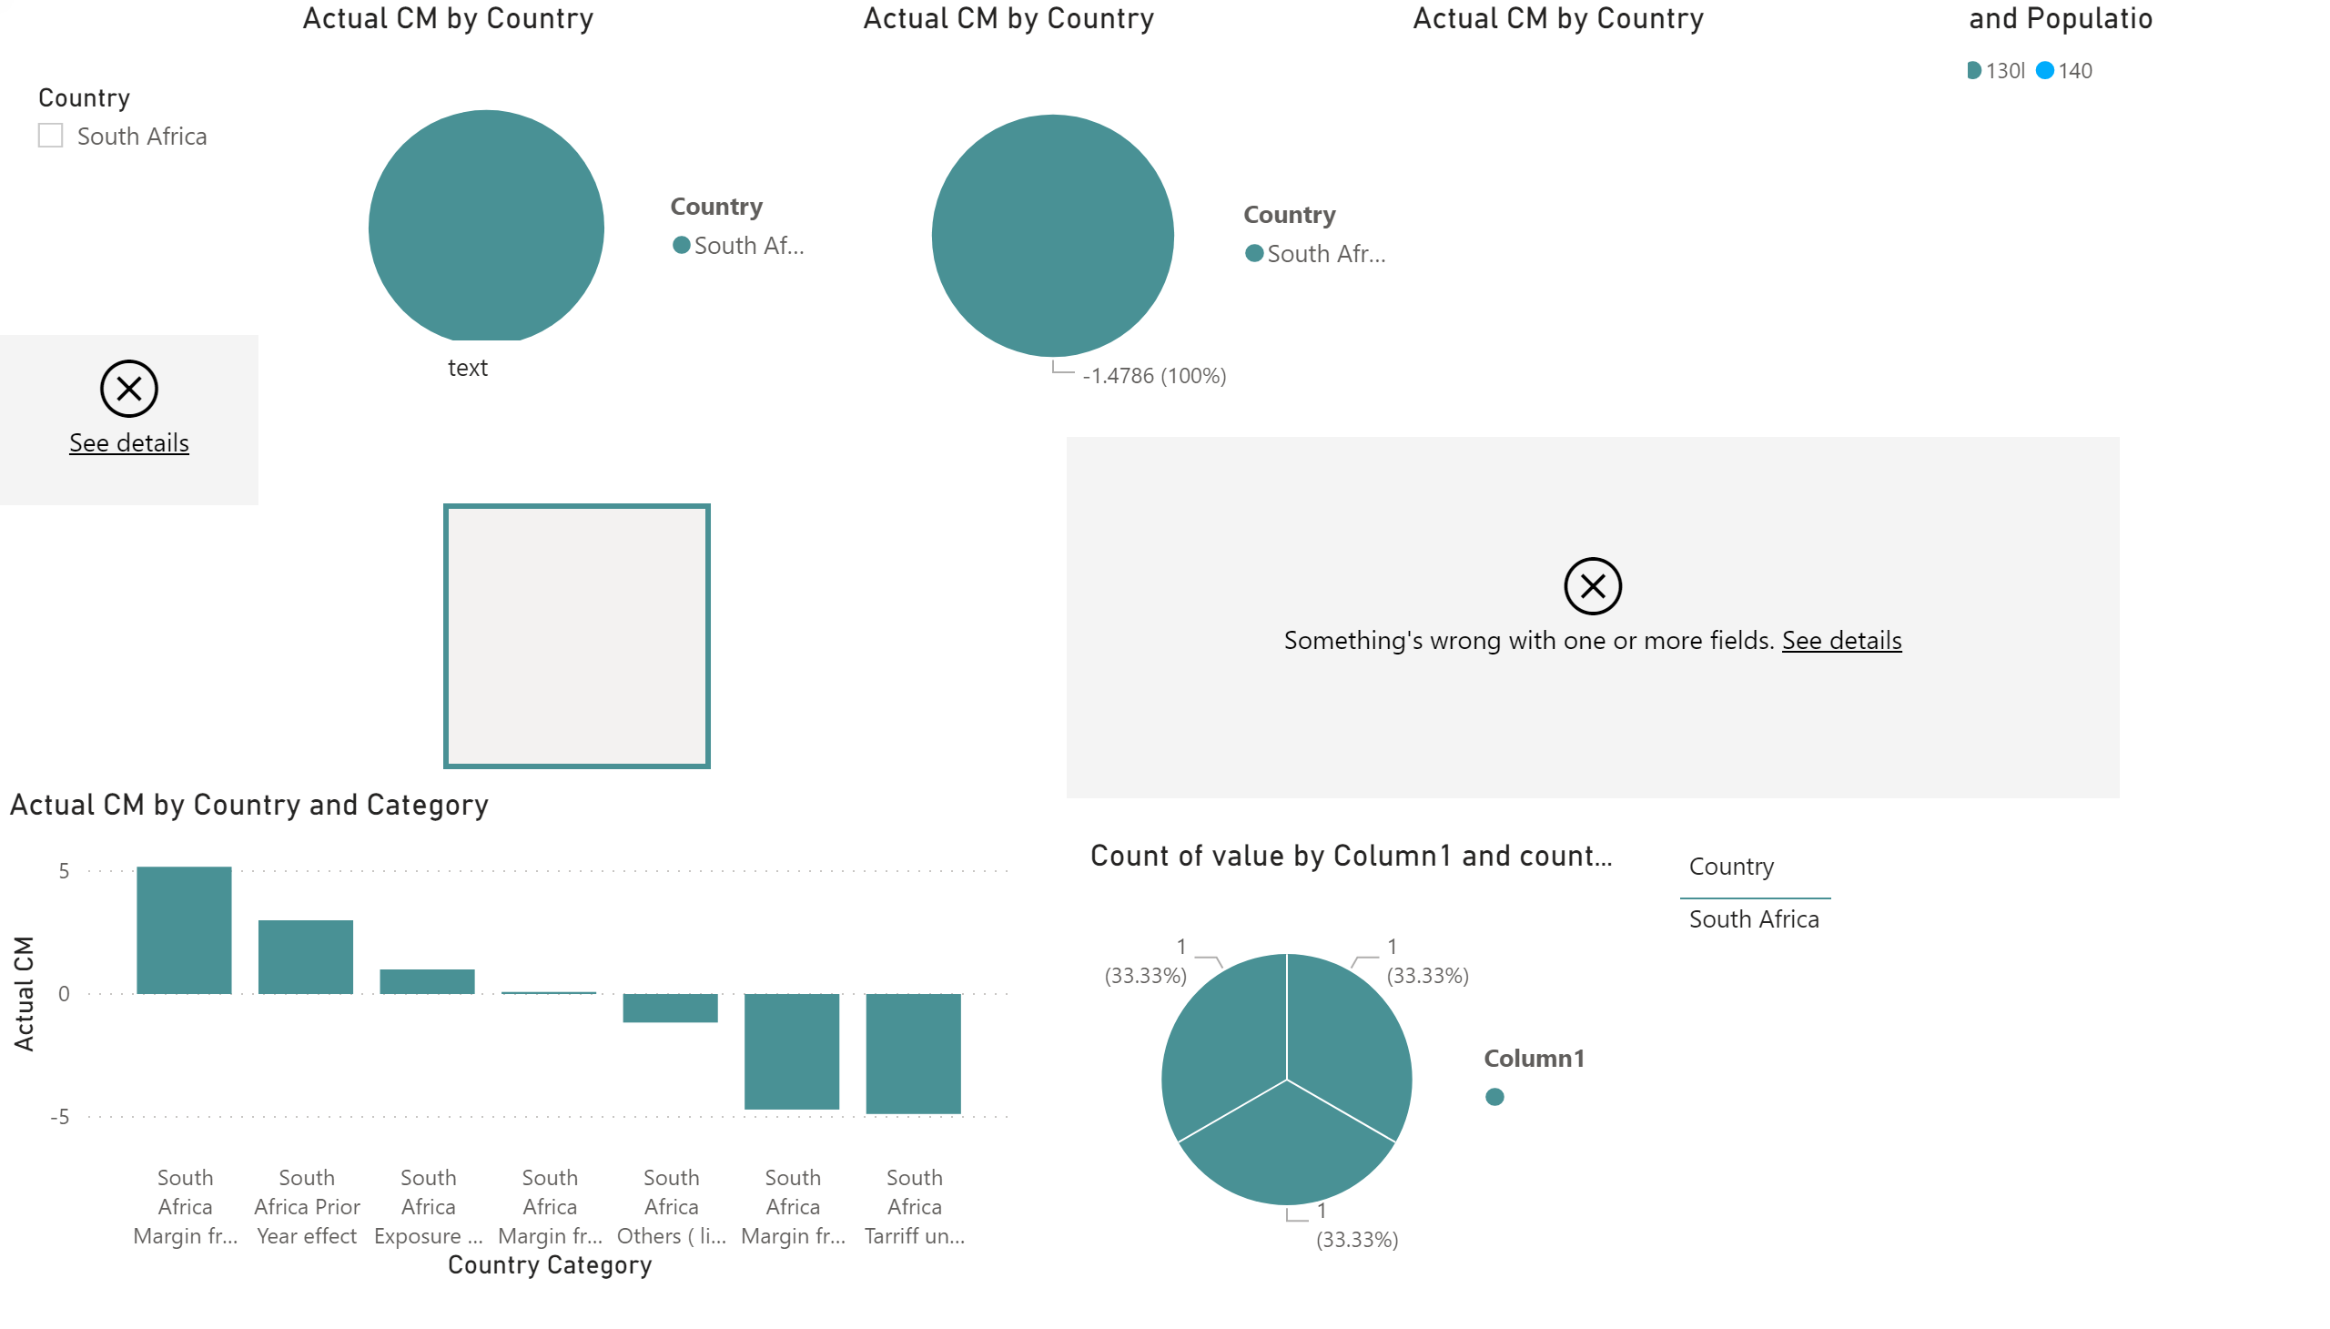

Slide 6
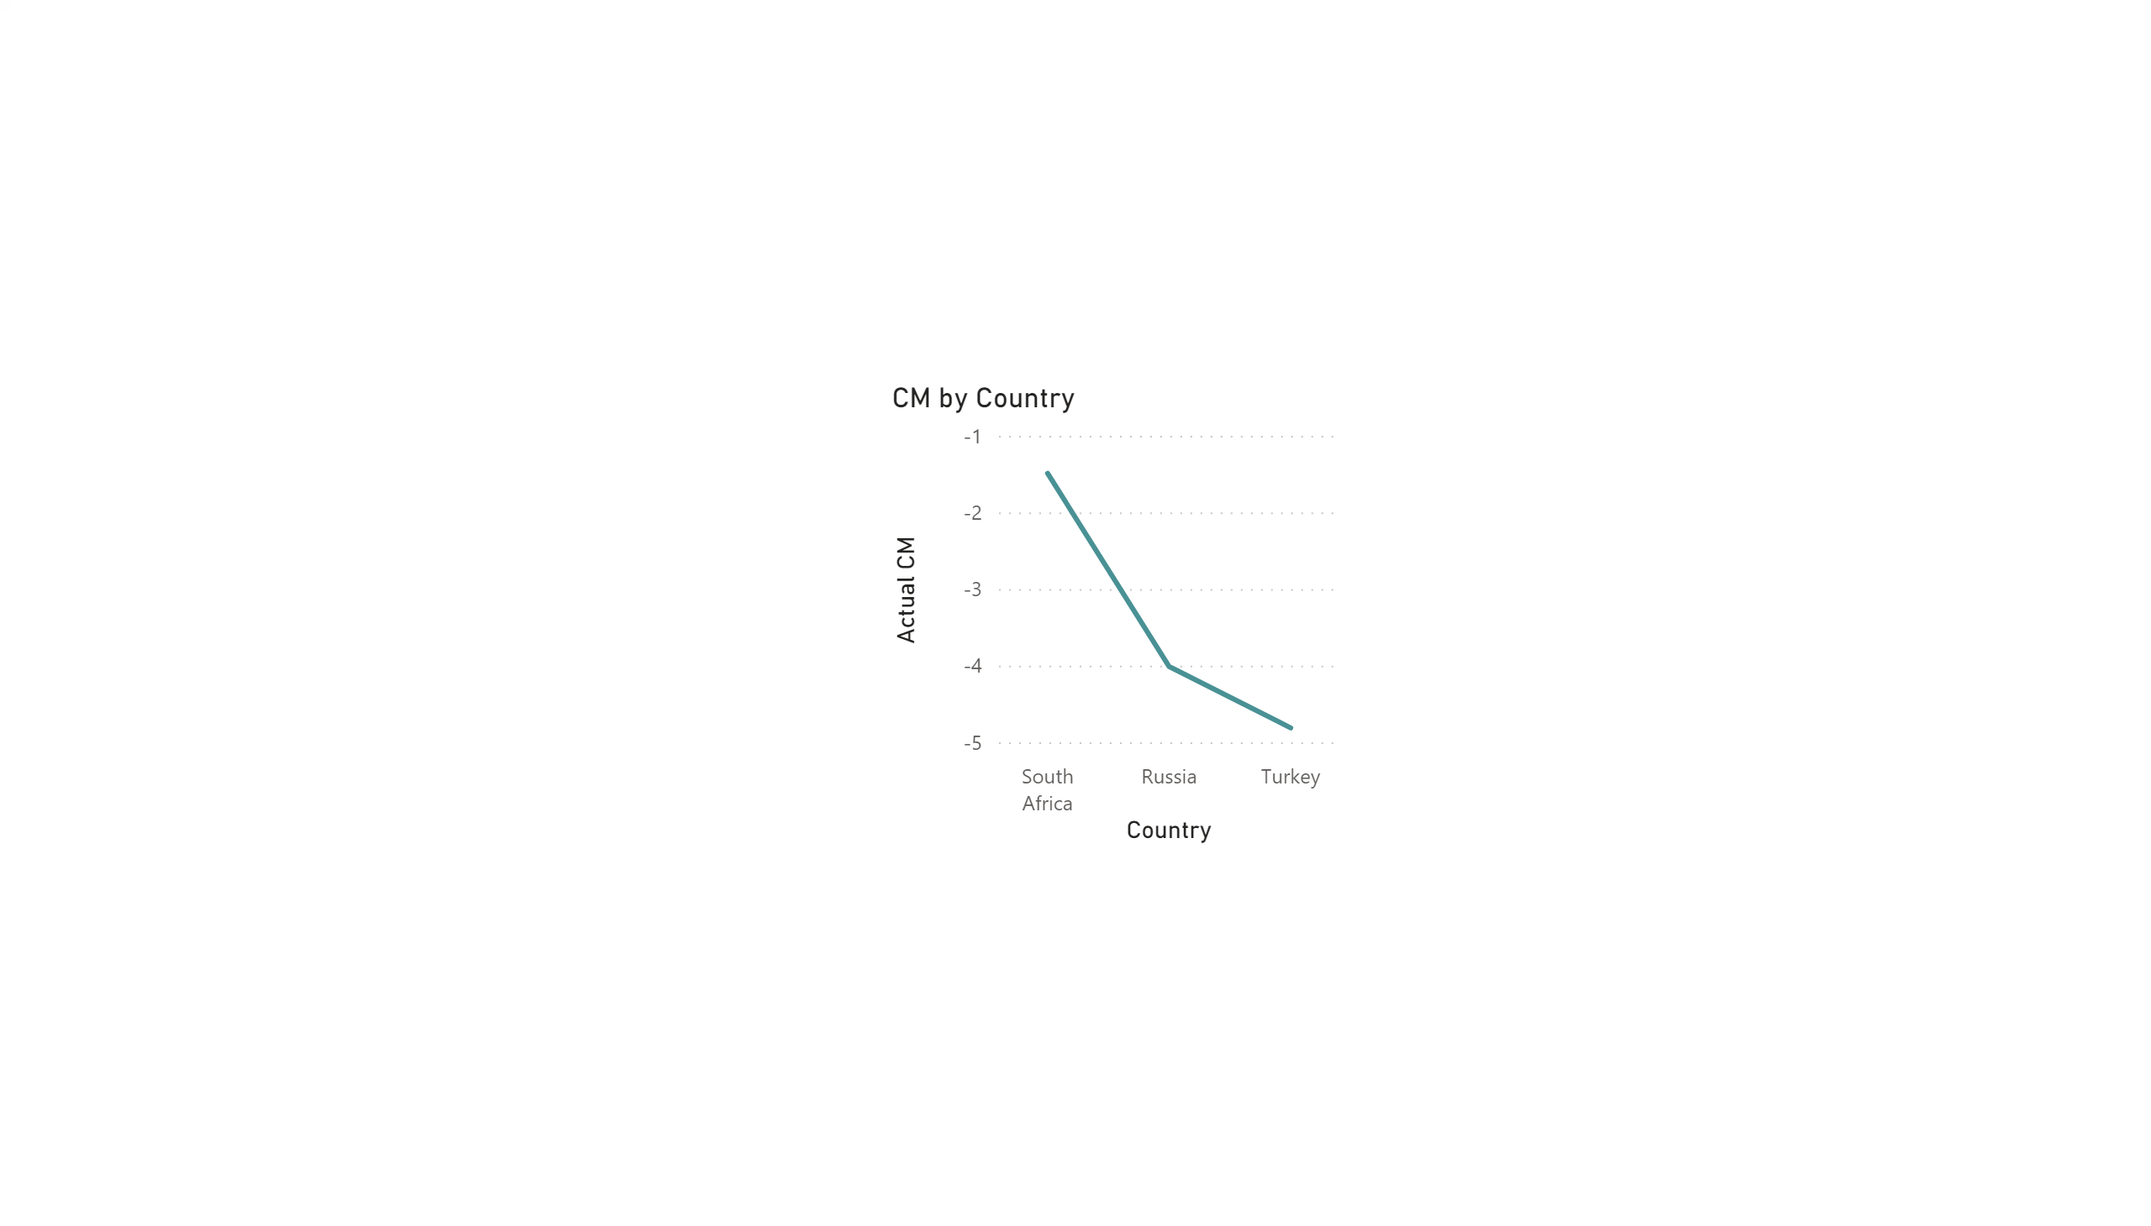

Slide 7
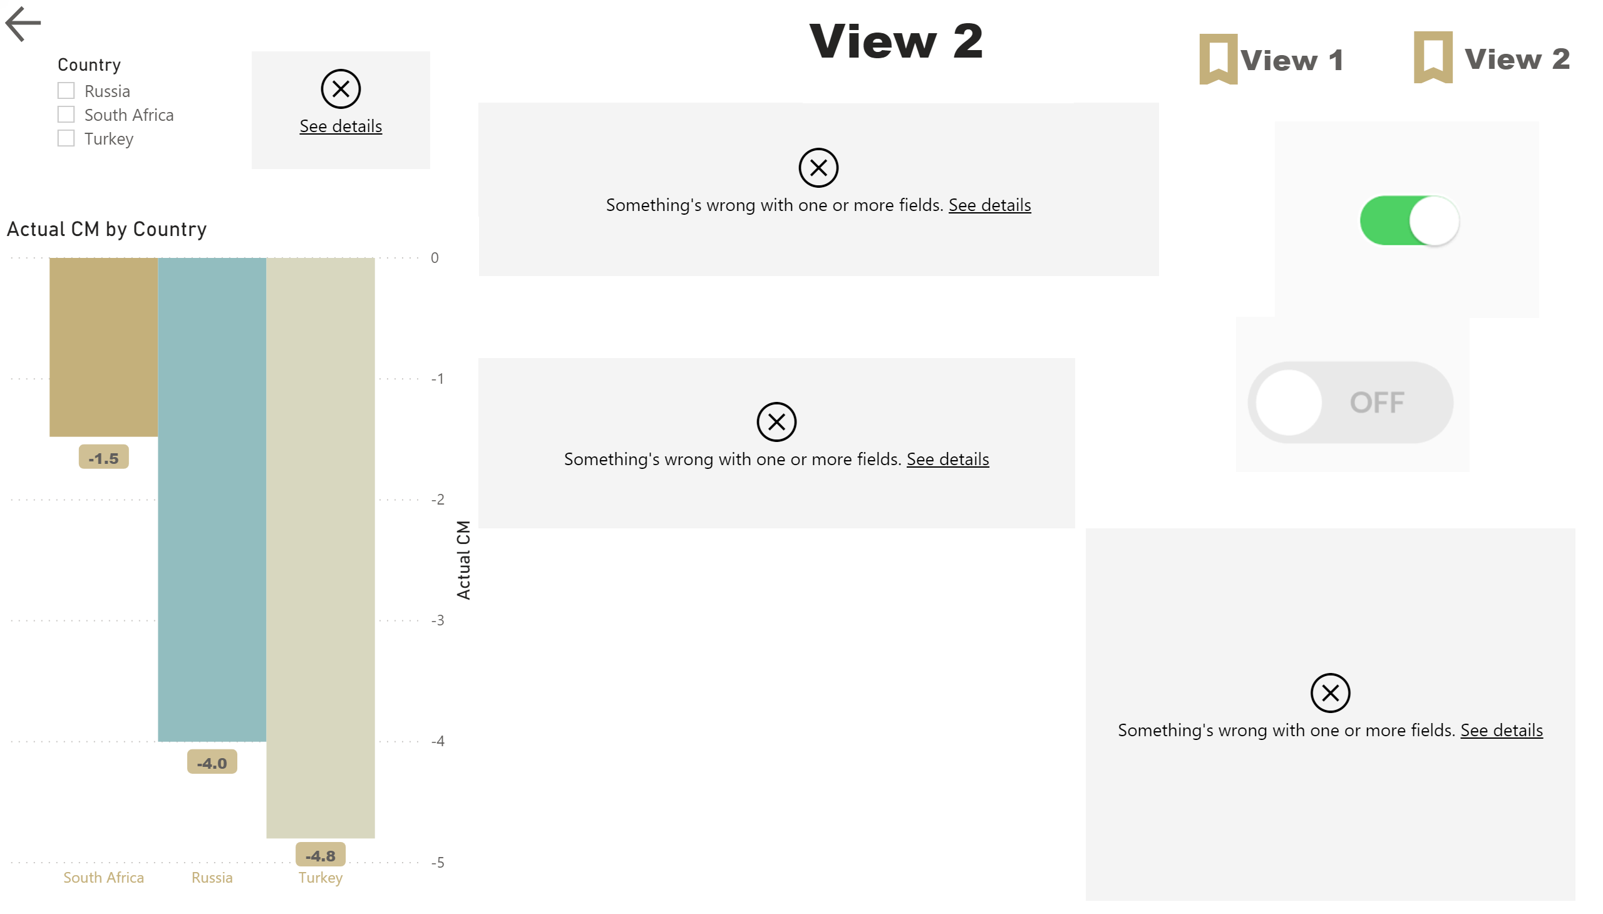

Slide 8
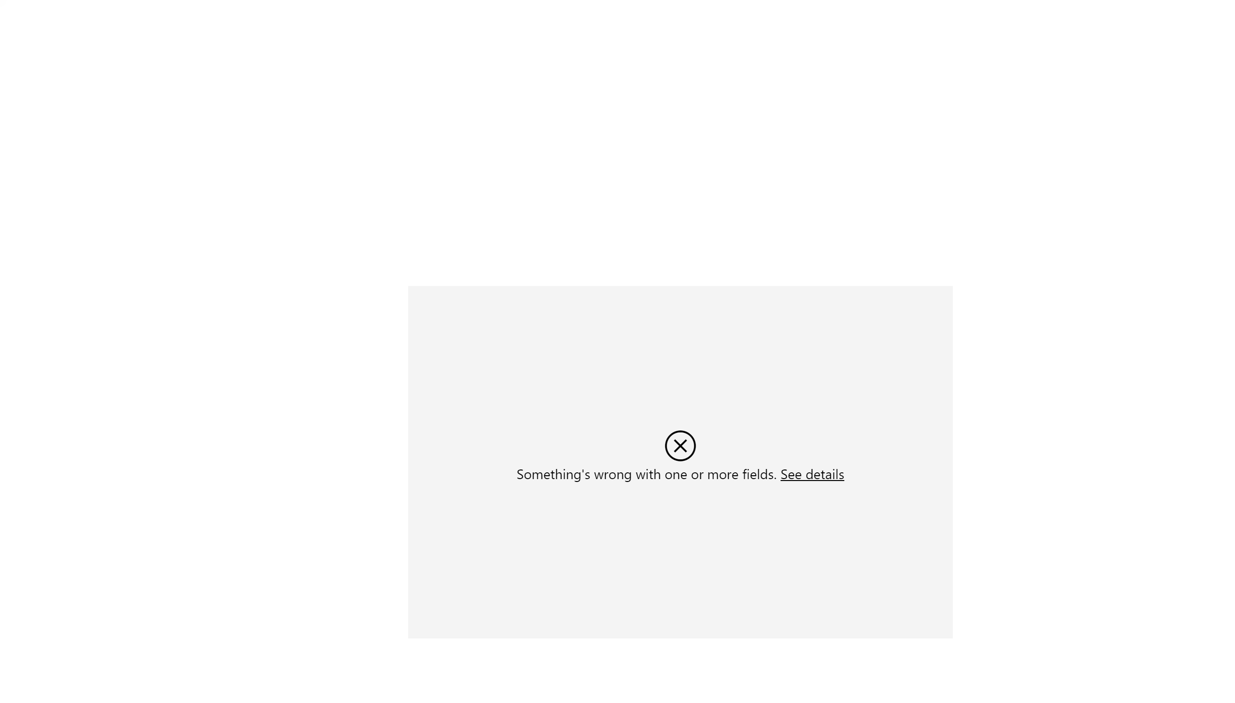

Slide 9
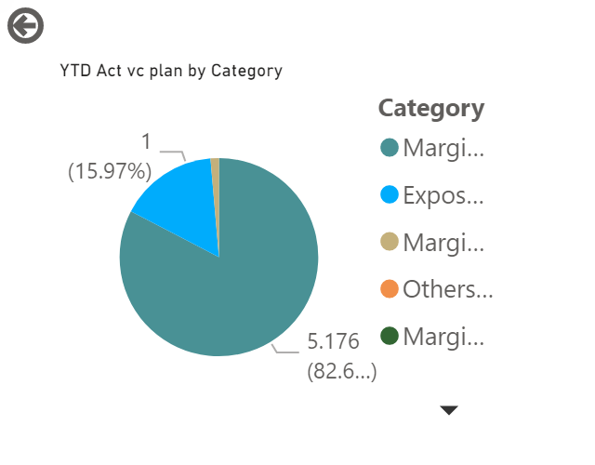

Slide 10
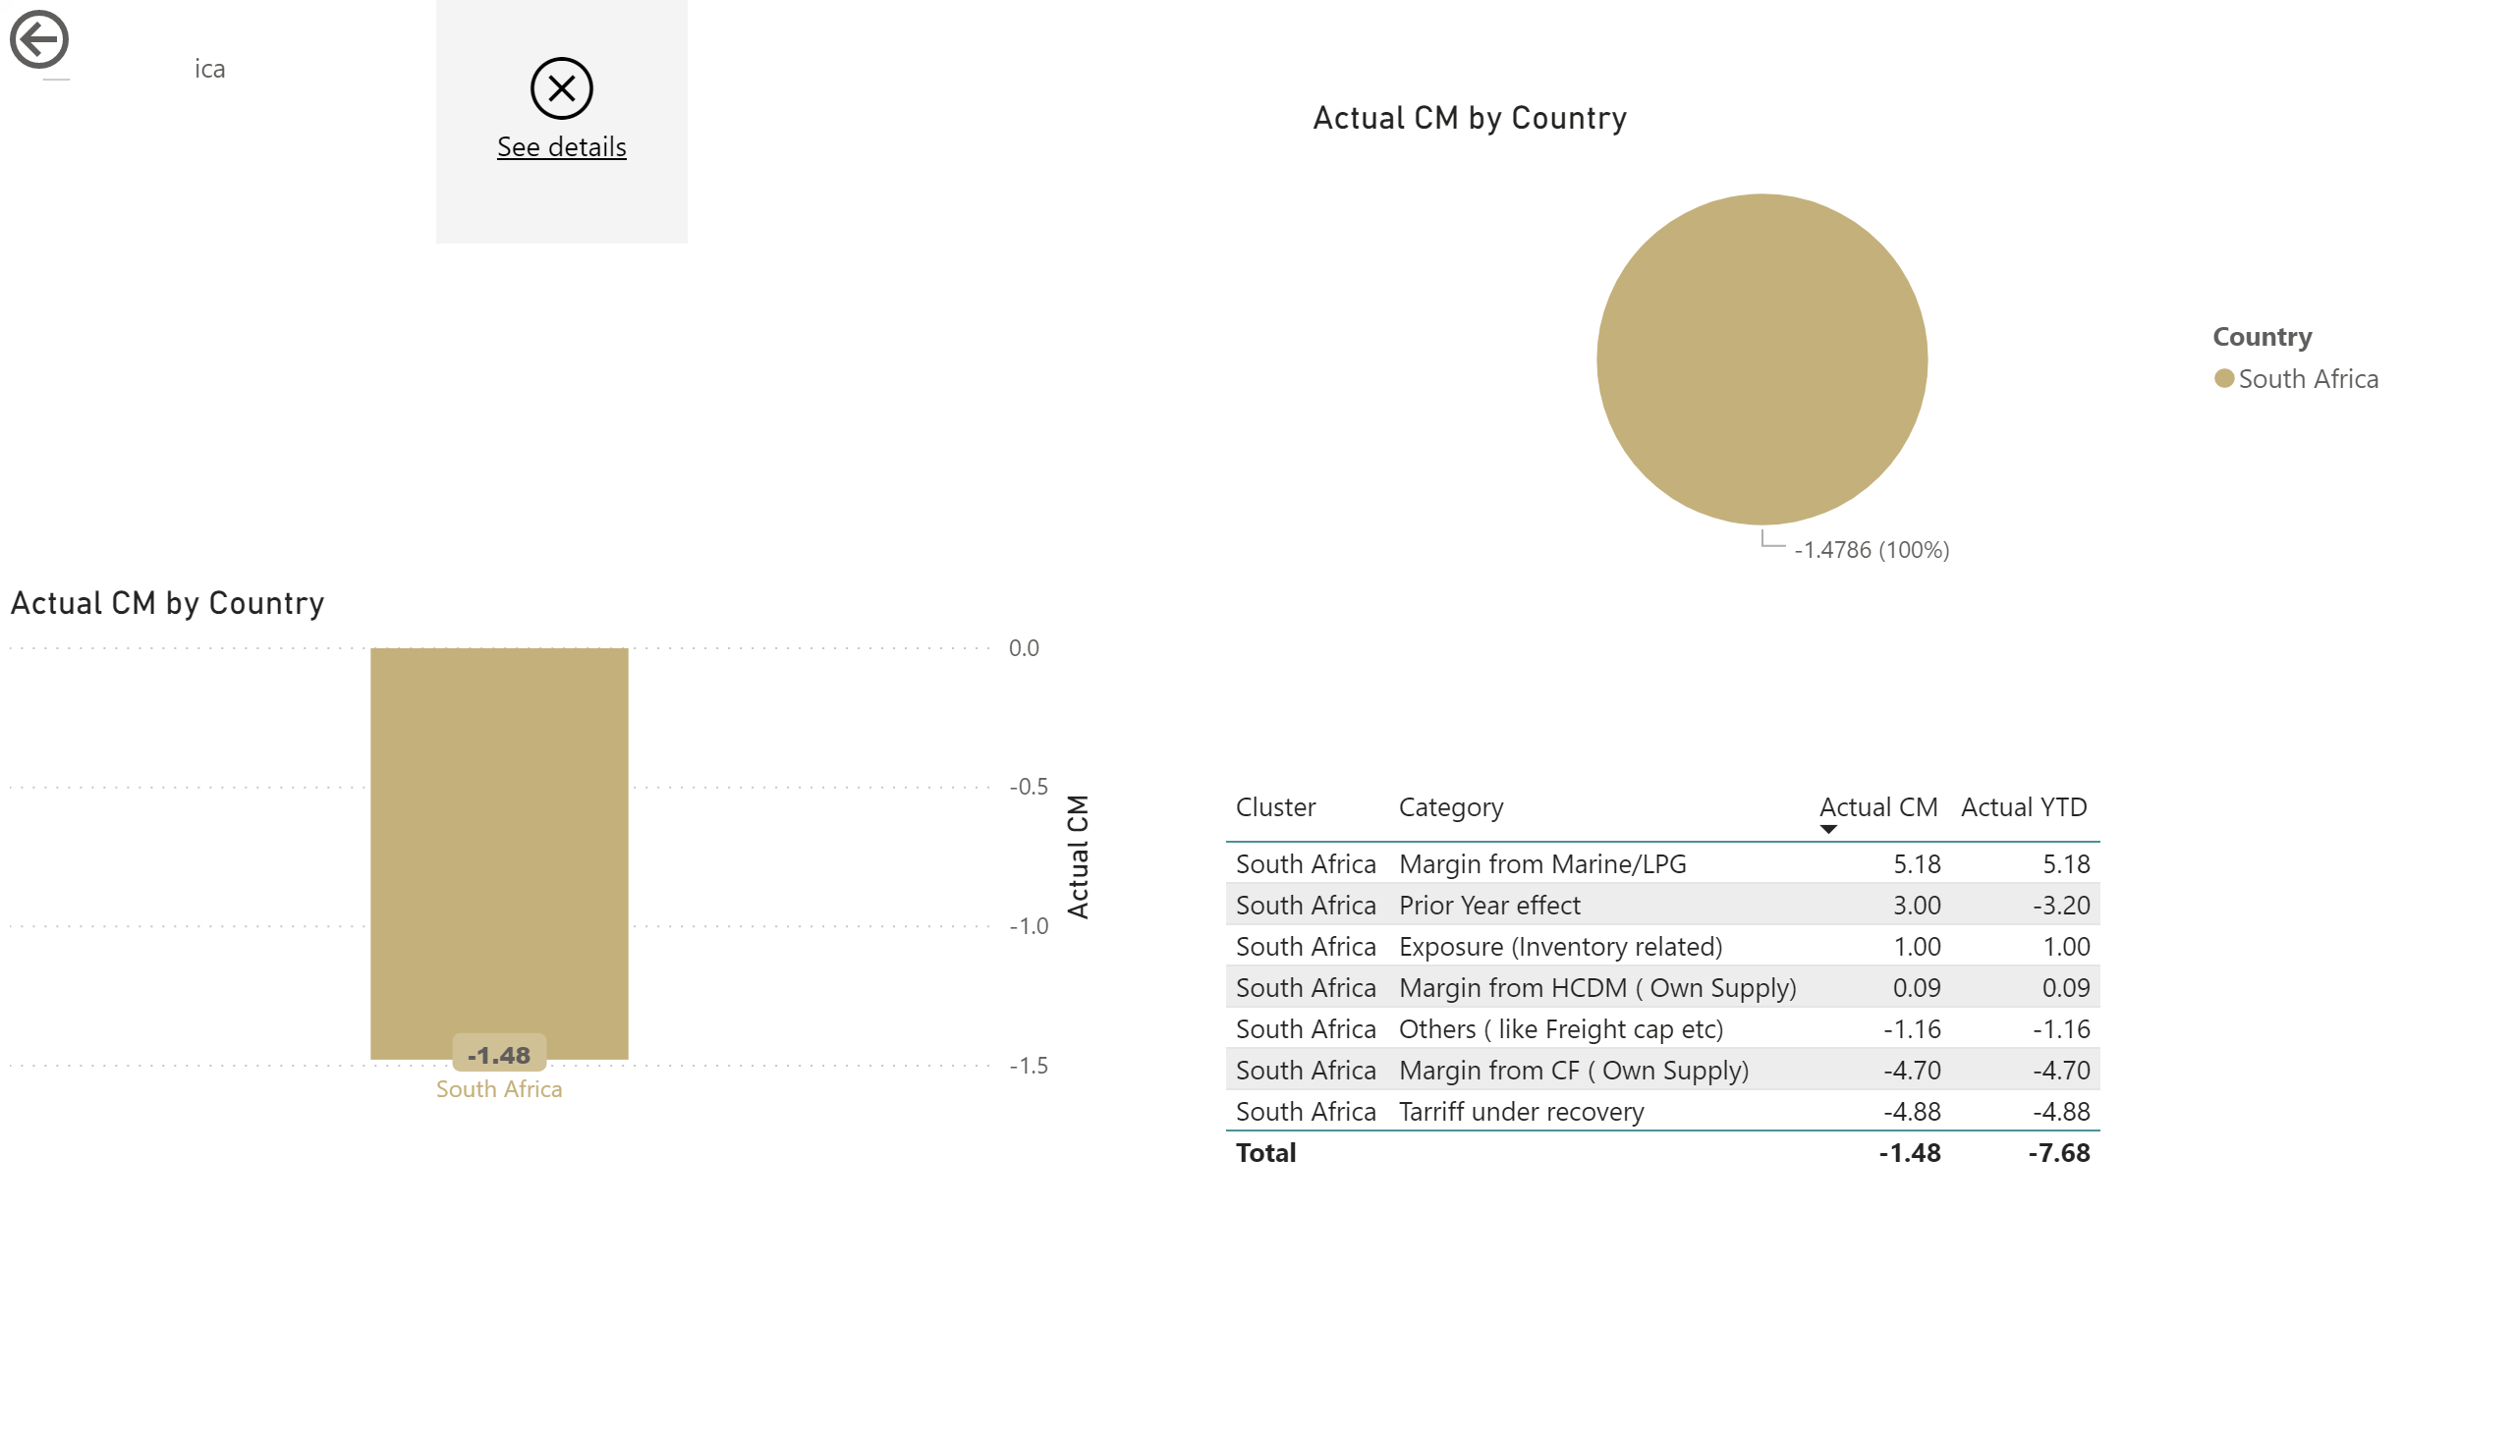

Slide 11
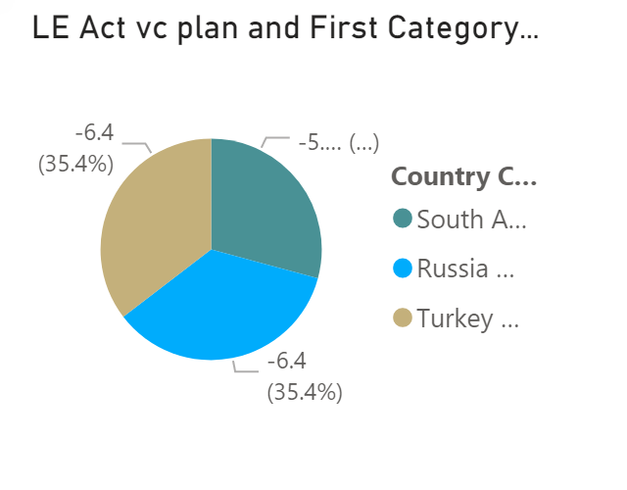

Slide 12


Slide 13
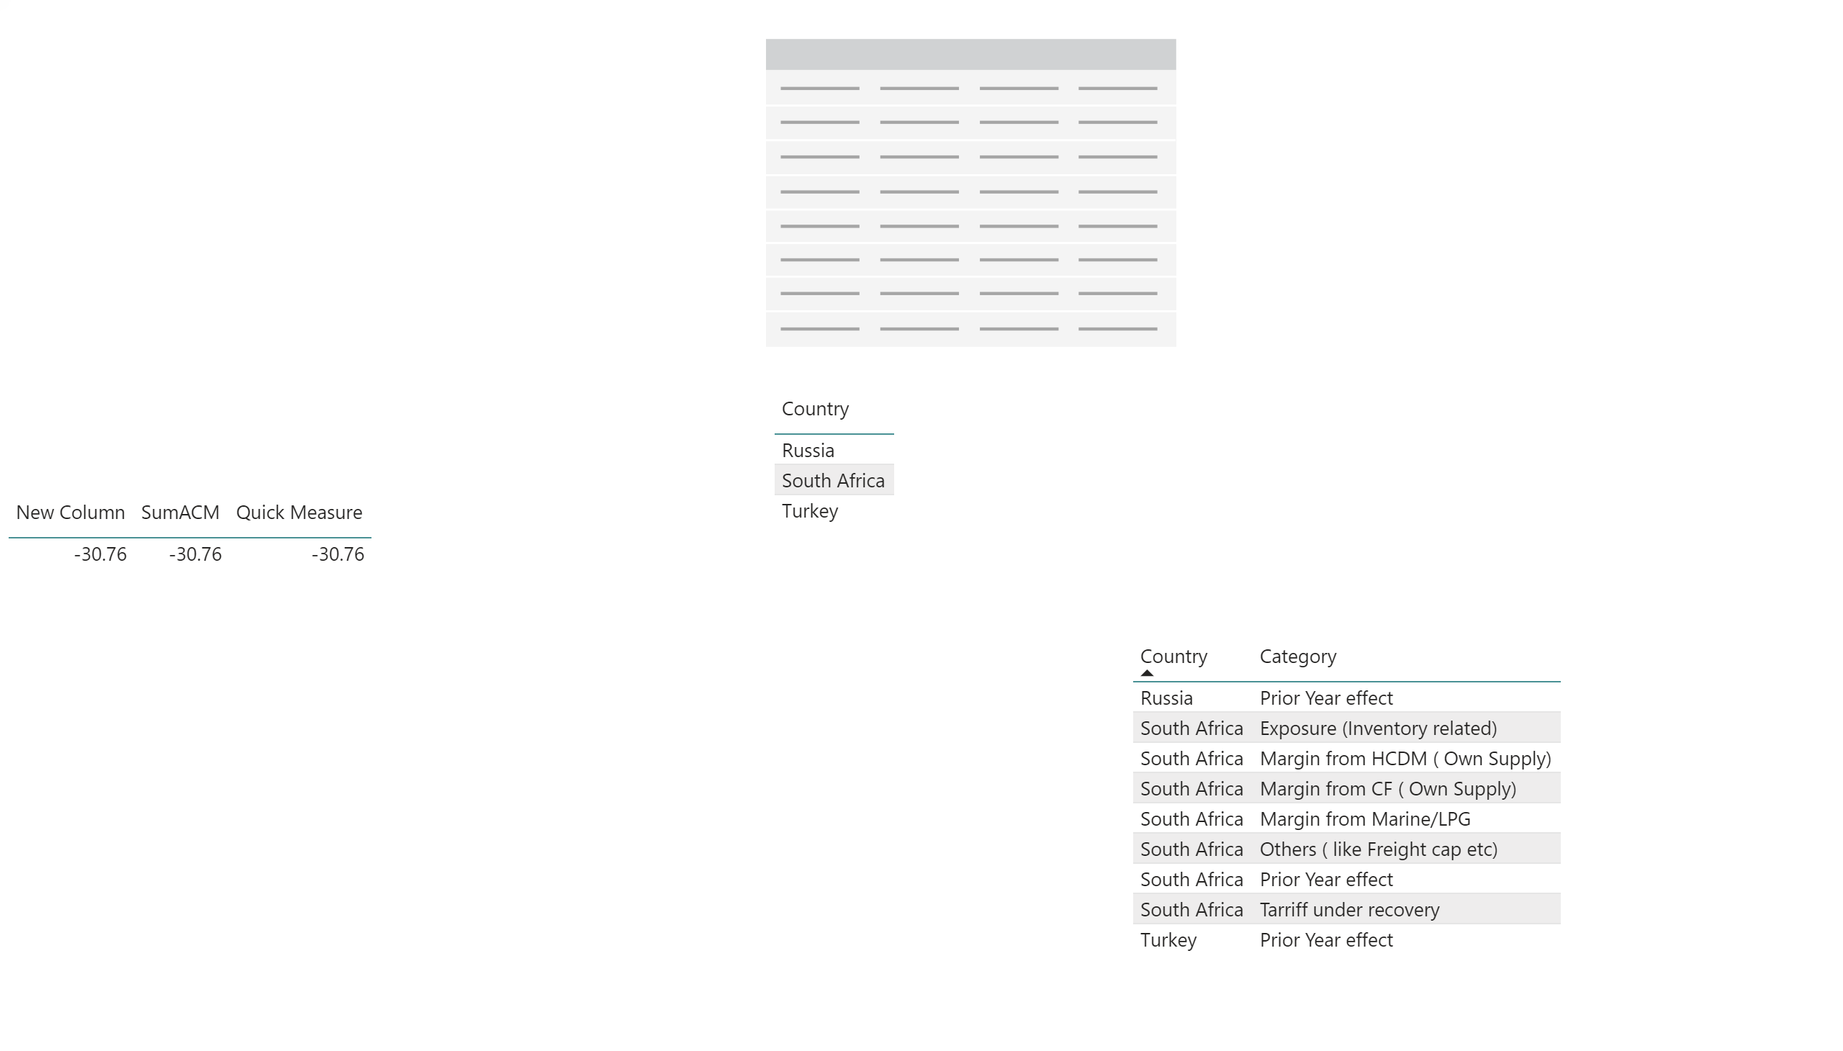

Slide 14


